Slide 1

SMART GARDEN
Esame di
Laboratorio IoT
a.a. 2020/2021
Gianlorenzo Occhipinti
829524

Slide 2
Project description
which
which
Smart Garden is an autonomous, fully configurable system that monitor the moisture level of the soil and water the plants in a smart way.
The system has a feature called smart rain, if the next day will rain with a high probability, the plants won’t be watered if their moisture soil level is not critical (under the half of the threshold).
The system has several kinds of capabilities, most of them are optional, and this means that a user can build the perfect system only for what he needs.
All the system works inside a net of microcontroller and in a decentralized way, so there isn’t a hub which represent a single point of failure.

Slide 3
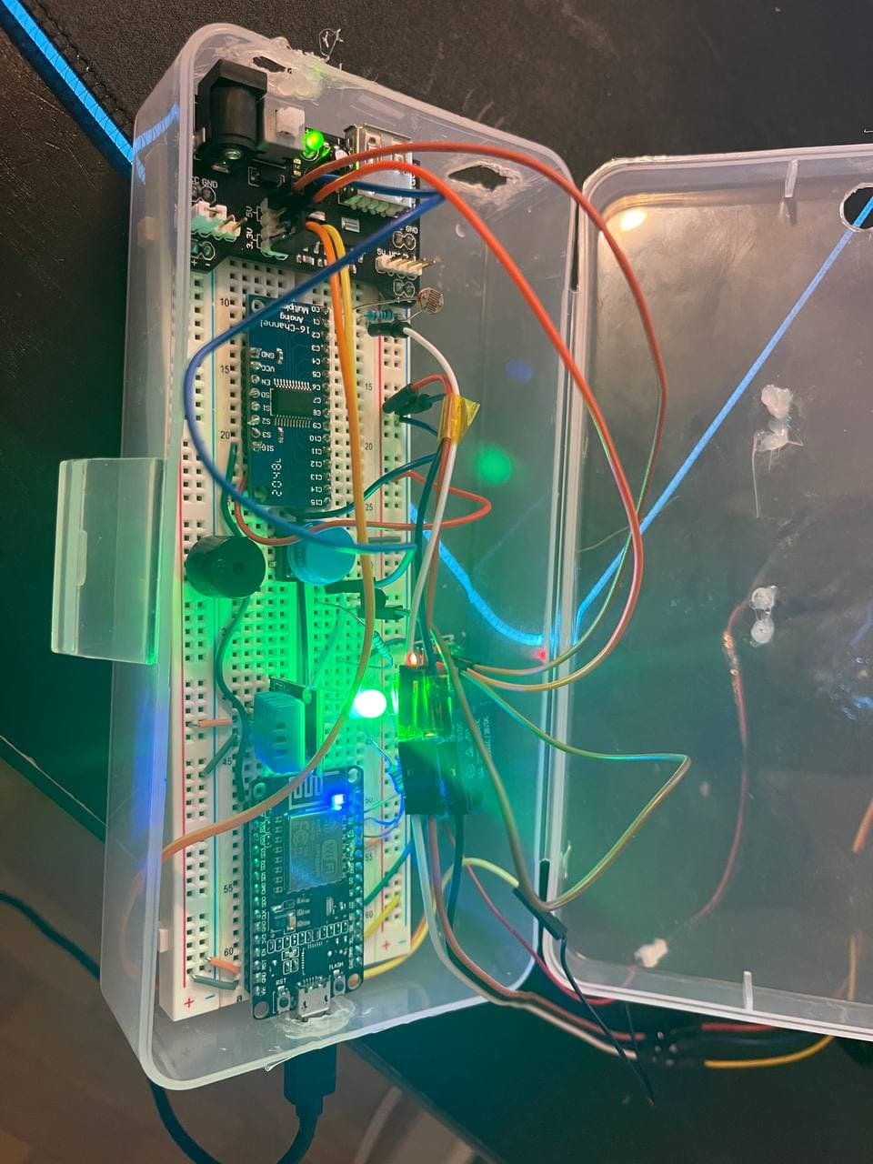
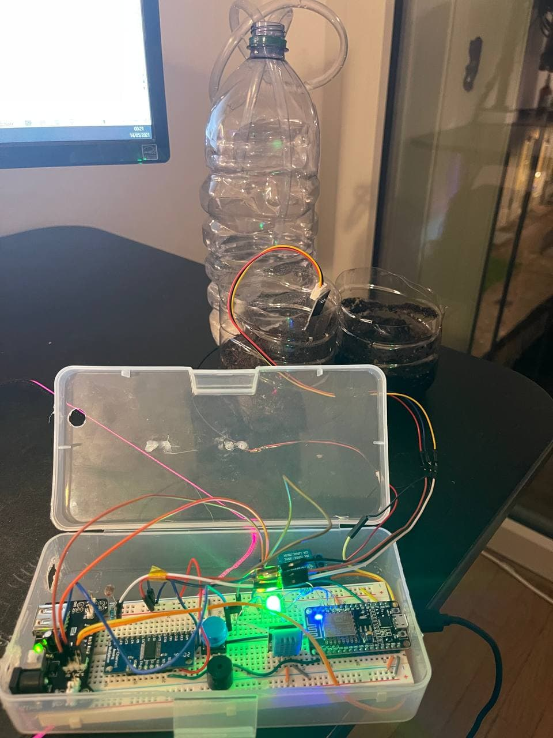
After 1st assignment

Slide 4
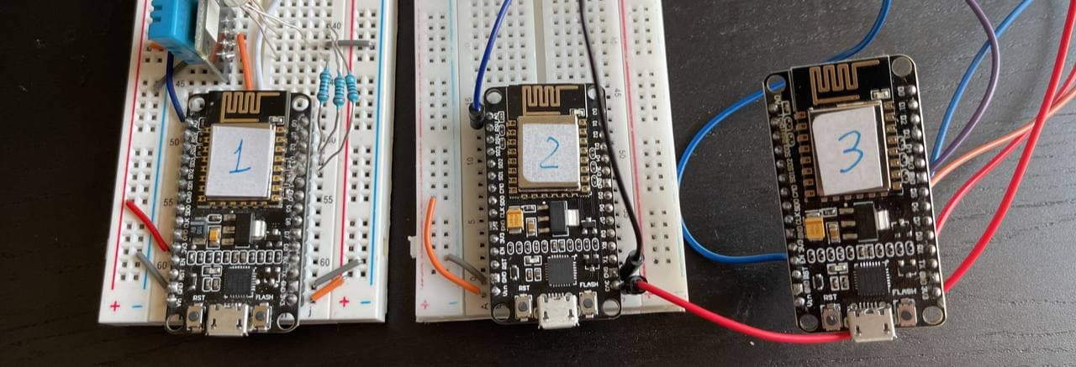
After 2nd assignment
SM1:
Led module
DHT11 module
BTN module
light module
SM2:
Moisture module
SM3:
Water module

Slide 5
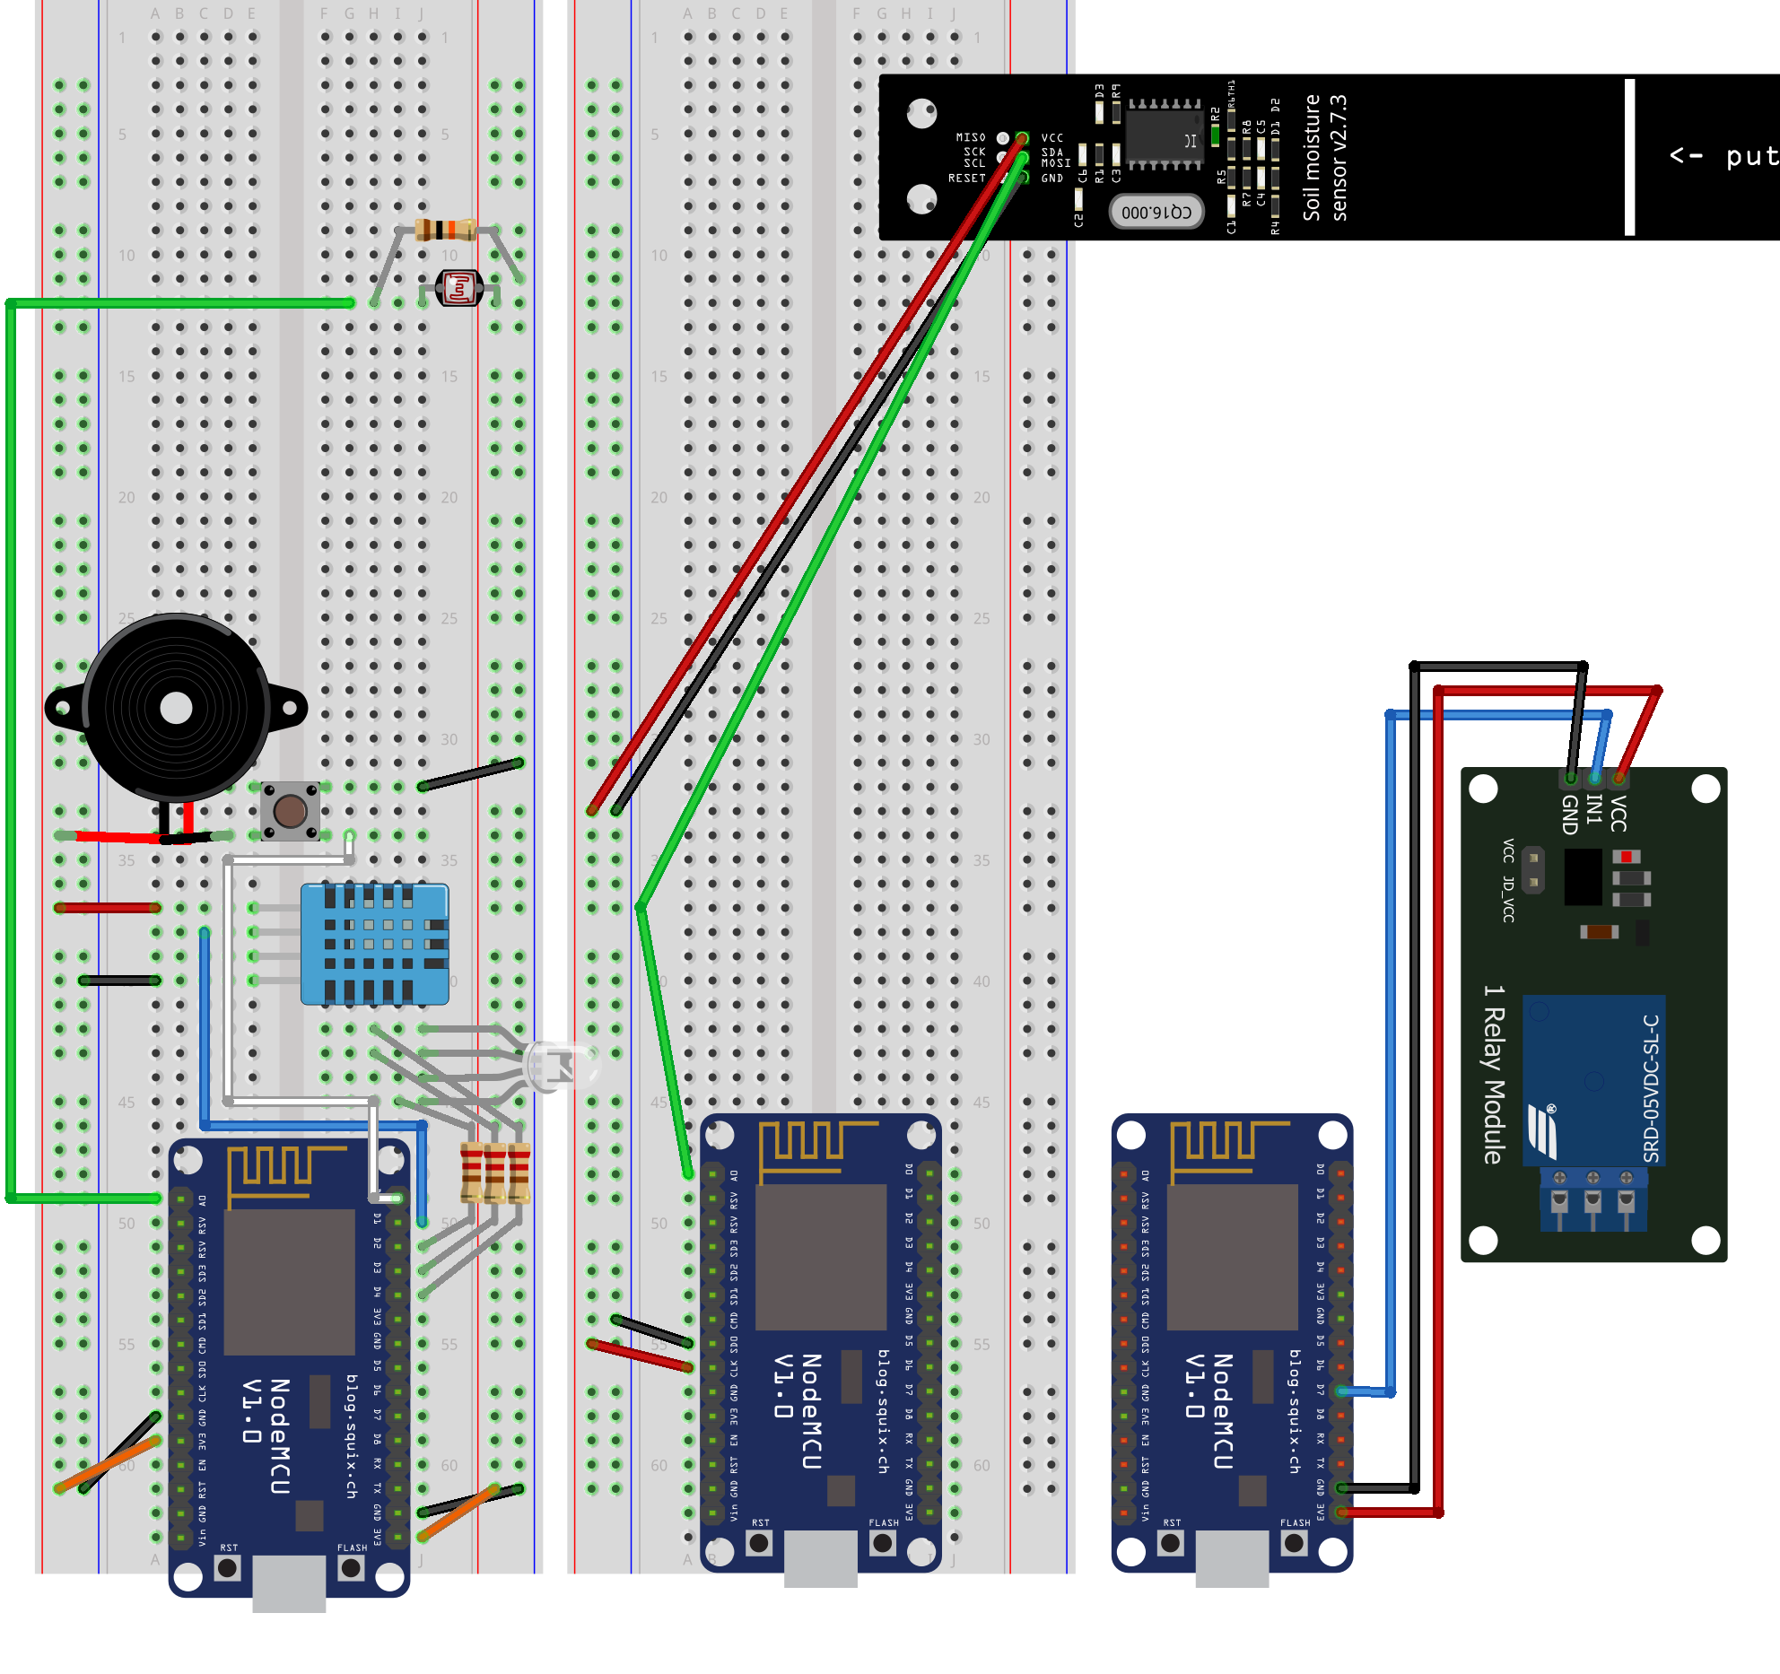
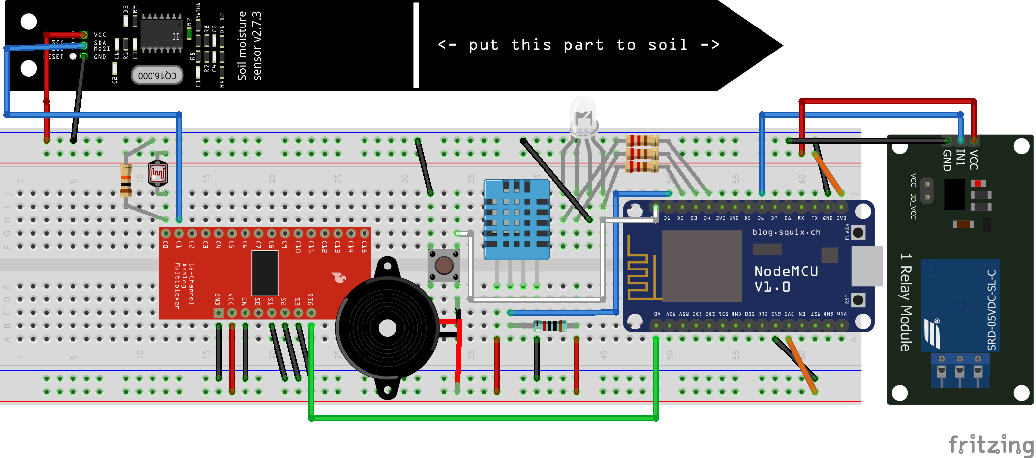
Previous schema
1st assignment schema
2nd assignment schema

Slide 6
SENSORS & MODULES

Slide 7
Sensor types
Read Only Sensor
Input Sensor
Sensor value logged every 5 seconds and pushed into the appropriate topic.
Reads from read only sensor can be disabled.
Sensor value logged every times an event occurs (e.g. button press).
Reads from input sensor cannot be disabled.
Photoresistor
Weather sensor (Weather API)
Moisture sensor
DHT11
Water tank level
State button
Telegram bot

Slide 8
Modules
One node can contain multiple modules. List of available modules:
Button module: handle the button and change the system status.
DHT11 module: handle the DHT11 sensor.
Led module: handle the system led that describes the system status.
Moisture module: handle the moisture module.
Photoresistor module: handle the photoresistor sensor.
Telegram module: handle the interaction with the telegram bot.
Water engine module: handle the water pump and virtualize water tank level sensor.
Weather module: get the weather data from open weather.
Undererlined modules can enter into deep sleep mode if meet certain conditions.

Slide 9
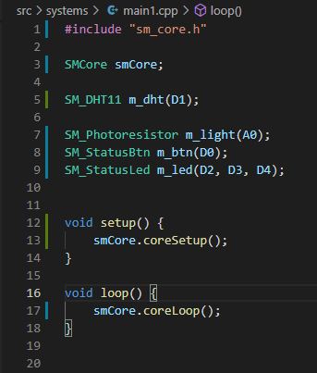
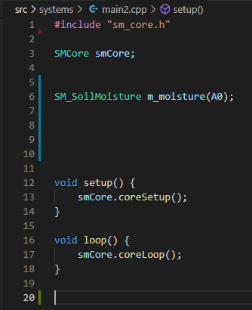
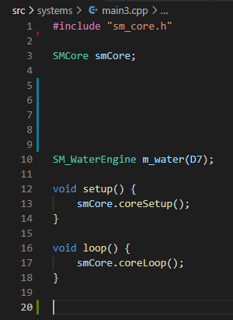
Node code example
SM1:
Led module
DHT11 module
BTN module
light module
SM2:
Moisture module
SM3:
Water module

Slide 10
SMARTGARDEN NETWORK PROTOCOL

Slide 11
Network protocol
Roles of the nodes are not hard coded inside the code. Each node can be either a master node, with a procedure called PROCLAIMING.
When a node joins into the smartgarden net, publish an MQTT packet into the discover topic (go3/discover) and if it doesn’t receive any reply from a master node, proclaims himself as master node. After that, the node has both a slave client and a master client.
The slave client, publish an REQ_JOIN packed into the discover topic and when it’s accepted from the master with an ACC_JOIN packet publish (if sensor’s reading are enabled) their reading into the appropriate topic (given from master when accept the client)

Slide 12
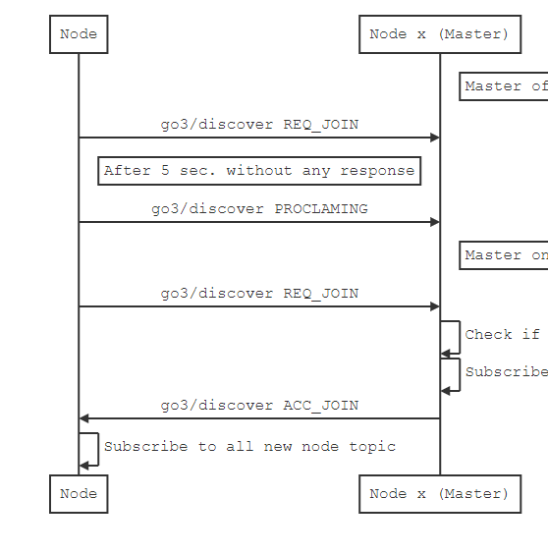
Network protocol
Roles of the nodes are not hard coded inside the code. Each node can be a master node, with a procedure called PROCLAIMING.
When a node joins into the smartgarden net, publish an MQTT packet into the discover topic (go3/discover) and if it doesn’t receive any reply from a master node (10s), proclaims himself as master node. After that the node can be considered both slave and master node.
The proclaiming procedure can start if the node has a MASTER NODE flag defined.

Slide 13
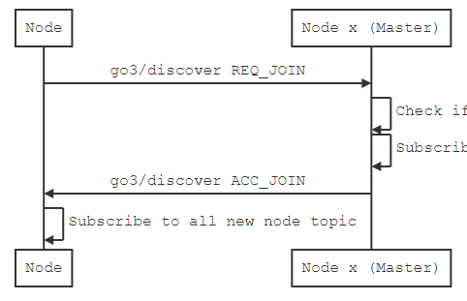
Network protocol
The slave client, publish an REQ_JOIN packed into the discover topic and when it’s accepted from the master with an ACC_JOIN packet publish (if sensor’s reading are enabled) their reading into the appropriate topic (given from master when accept the client)

Slide 14
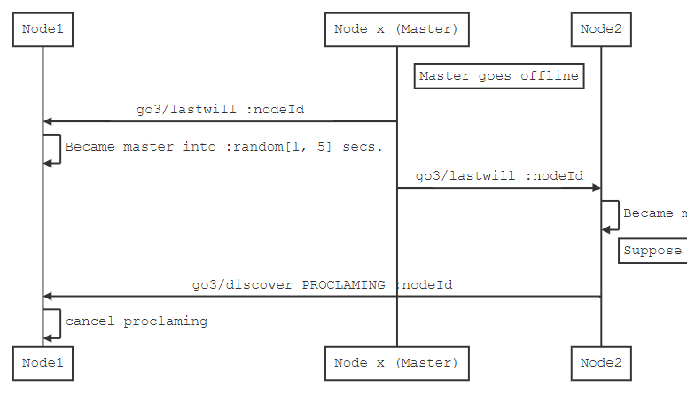
Network protocol
If the master goes offline all the slaves receive a message into the last will topic, sets a random timer and who consume it before others, proclaims himself as master.
This election mechanisms starts only in the nodes that have the MASTER NODE flag defined.

Slide 15
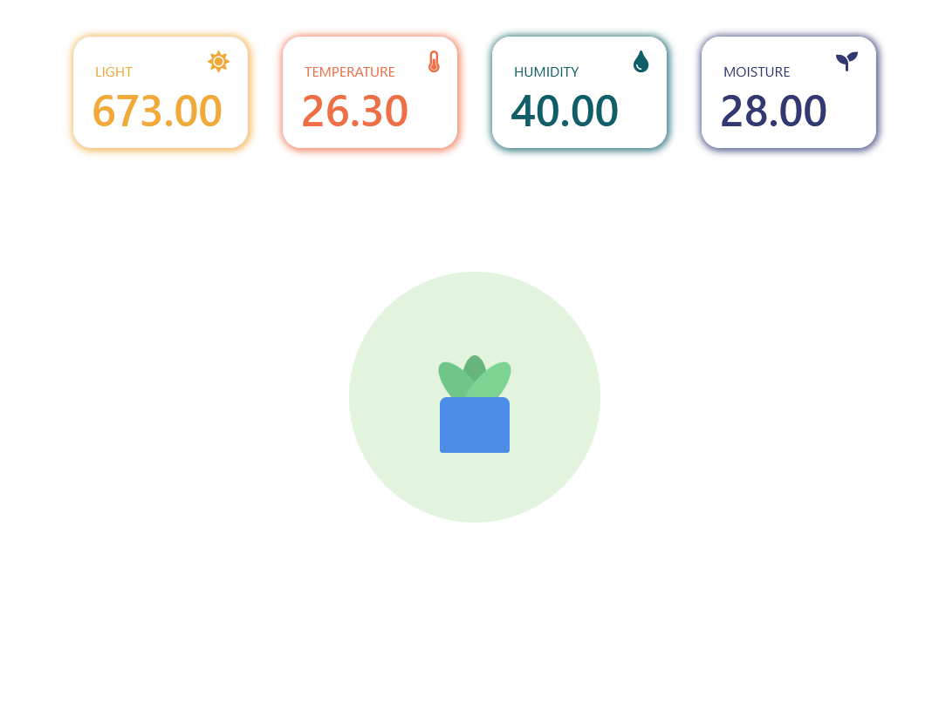
Network
Smartgarden network
smartgarden.local
(external)
CLIENT 1
CLIENT 2
CLIENT 3
Master
Slave 1
Slave 2
Slave n
MQTT
SQL DB
INFLUX DB
web gui
Optional

Slide 16
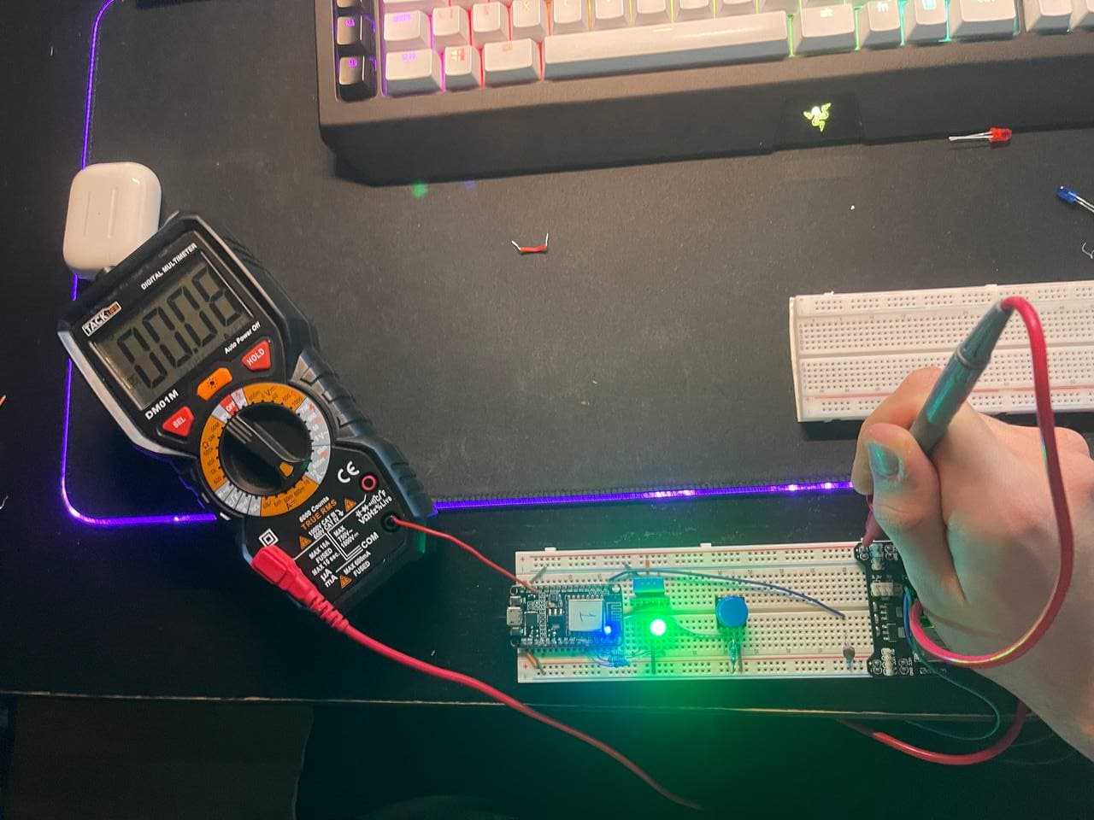
NODE POWER CONSUMPTION
All those measurements are taken with a digital multimeter.
Node type | Durability with a 18650 battery (3500 mAh)
Master node without modules | 44h
Slave node no deep sleep | 58h
Slave node with deep sleep (once every 8h) | 4177h = 172d

Slide 17
SYSTEM IN ACTION

Slide 18
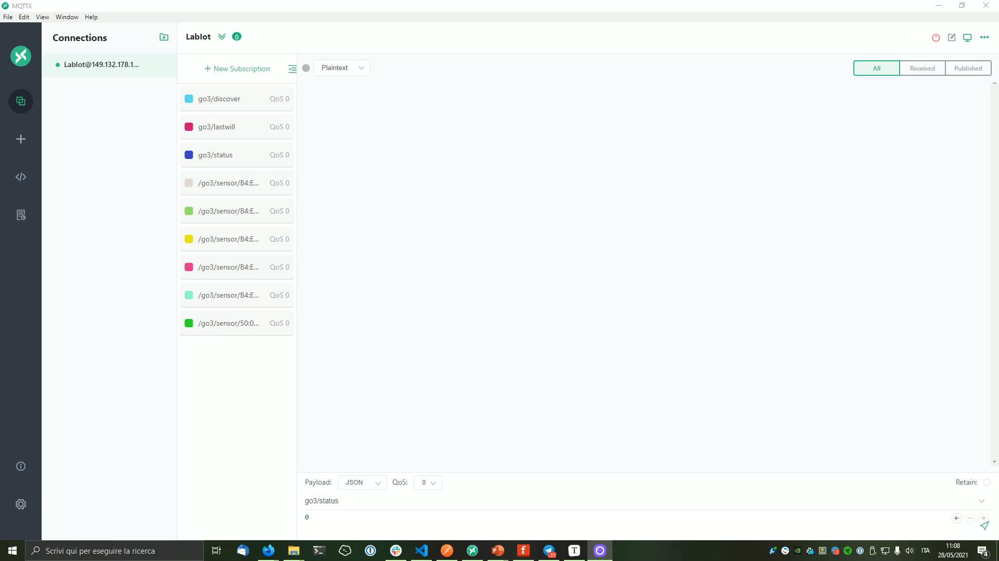
NETWORK PROTOCOL

Slide 19
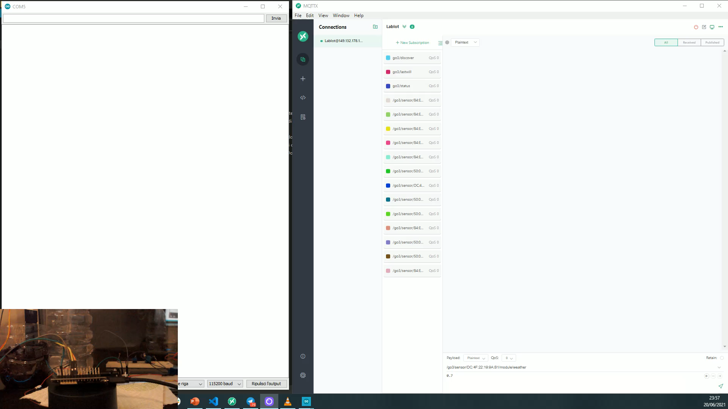
SMART RAIN FEATURE

Slide 20
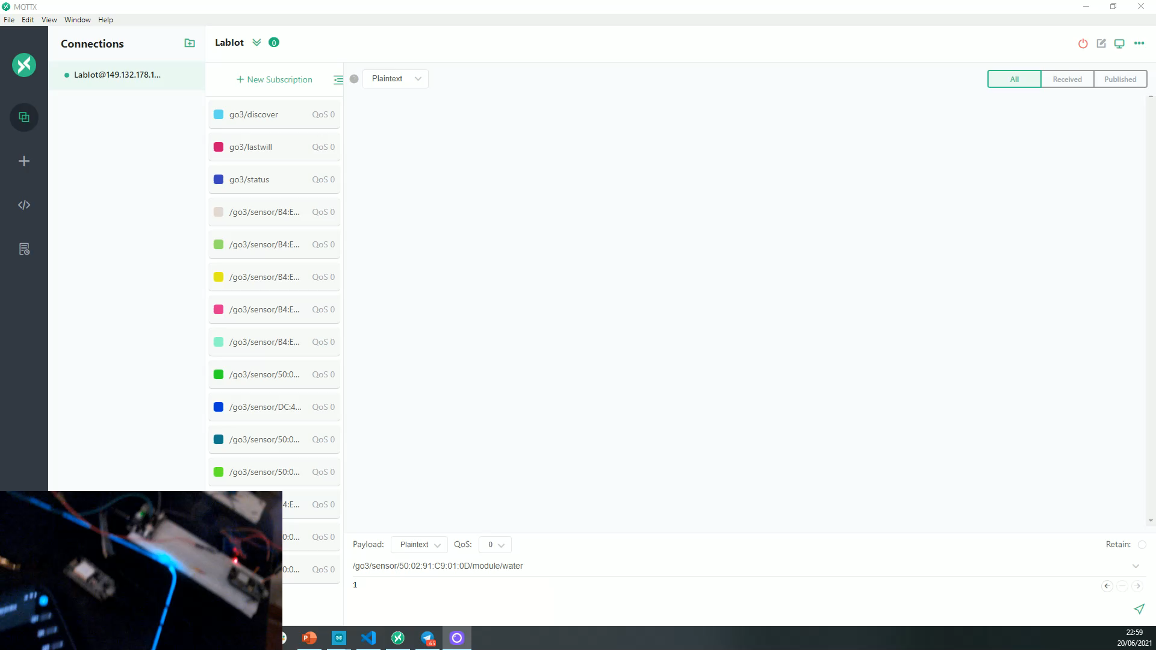
TELEGRAM MODULE CONTROL

Slide 21
A brief recap
through
through
Smart Garden is a system compound by different nodes, each one with the needed modules. All the nodes communicate through a specific designed protocol constructed over MQTT.
The current master node has a webserver reachable at “smartgarden.local” which provides:
/: homepage showing sensor values and system reading stats.
/stats: return a JSON with all sensors values (light, temp, hum, … )
/config: return a JSON with all master configs (sensorUpdateInterval, systemStastus, moistureTreshold, …)
All the config can also be set with a POST request, and also they will be immediately saved into the SQL database.
The master node can optionally use an SQL DB for storing network topology, configs and alarms and it also can optionally use INFLUX DB for storing the sensor values.
The system is almost always available at “smartgarden.local” because if the master node goes down, a random eligible slave node became the new master node.

